Slide 1

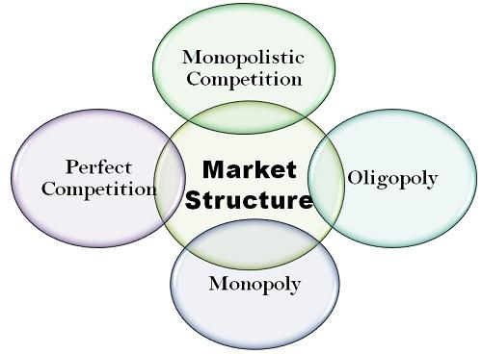

Market Structure
Engineering Economics

Slide 2
Syllabus
Market Structure:
Perfect Competition: Meaning and characteristics, Price Output Determination
Case Study : The Exchange Rate of USD and the profitability of US firms
Monopoly: Meaning, characteristics, Price Discrimination
Case Study: Monopoly in the Mumbai City Taxi Industry, Discriminating Monopoly Indian Railway
Monopolistic Competition: Meaning and characteristics
Case Study : Advertisement Competition in India
Oligopoly: Meaning, characteristics, Kink Demand Curve, Game Theory
Case Study: OPEC (The Organization of Petroleum Exporting Countries) Cartel

Slide 3
Market
Market
In economics, market means a social system through which the sellers and purchasers of a Commodity or a service (or a group of commodities and services )can interact with each other.

Slide 4

Market
In common language, market means a place where goods are purchased.
However, in economics, market means an arrangement which establish effective relationship between buyers and seller of a commodity. Hence, each commodity has its own market.

Slide 5

Market
They can participate in sale and purchase.
Market does not refer to a particular place or location.
It refers to an institutional relationship between purchasers and sellers.
Market is an arrangement which links buyers and sellers.
A market can be of different types.
The market differ from one another due to differences in the number of buyers, number of sellers, Nature of the product, influence over price, availability of information, conditions of supply etc.
Economists discuss four broad categories of market structures:
Perfect Completion
Monopoly
Monopolistic Competition
Oligopoly

Slide 6
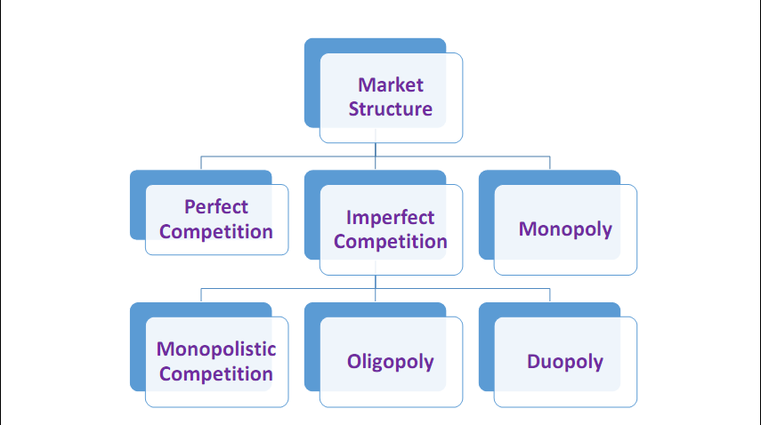
Market Structure

Slide 7
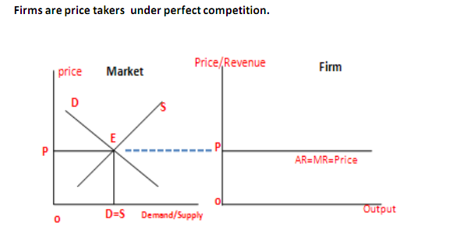
Perfect Competition
Perfect competition is a market structure in which large number of sellers sell a homogenous product at uniform price.

Slide 8
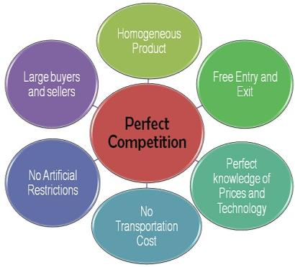
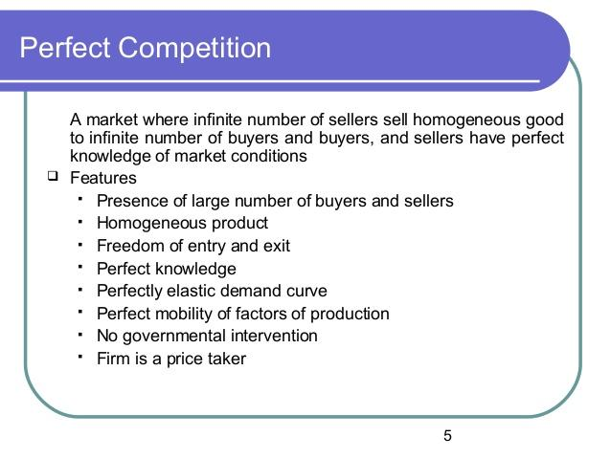
Perfect Competition

Slide 9
Perfect Competition
A market is said to be Perfectly Competitive if it satisfies the following features:-
(i) Large number of buyers and sellers : Under perfect competition, there exists a large number of sellers and the share of an individual seller is too small in the total market output.
As a result a single firm cannot influence the market price so that a firm under perfect competition is a price taker and not a price maker. Similarly, there are a large number of buyers and an individual buyer buys only a small portion of the total output available.
(ii) Homogenous goods : Under perfect competition all firms sell homogenous goods which are identical in quantity, shape, size, colour, packaging etc. So the products are perfect substitutes of each other.

Slide 10
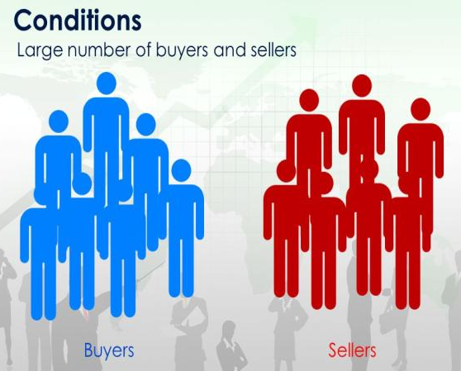
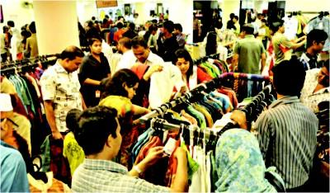
Large Number Of Buyers And Sellers

Slide 11
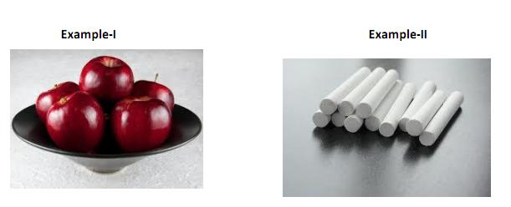
Perfect Competition
HOMOGENOUS Products : Identical Or Perfect Substitutes

Slide 12
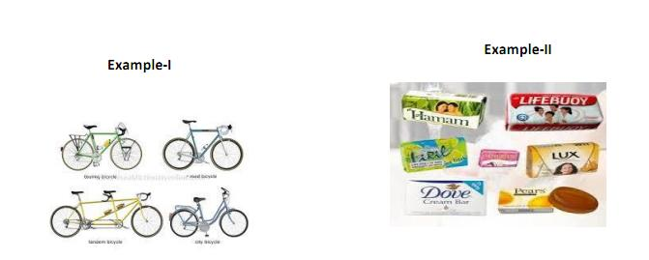
Perfect Competition
Differentiated Products: Similar But Not Identical Or Different But Close Substitutes

Slide 13
Perfect Competition
(iii) Price is uniform: as the products of the different sellers in the market are homogenous.
The price is determined forces of demand(buyer’s bidding) and supply (sellers bidding) in the market and accepted by the all sellers are price takers in market.
Hence firms under perfect competition are called price-takers.

Slide 14
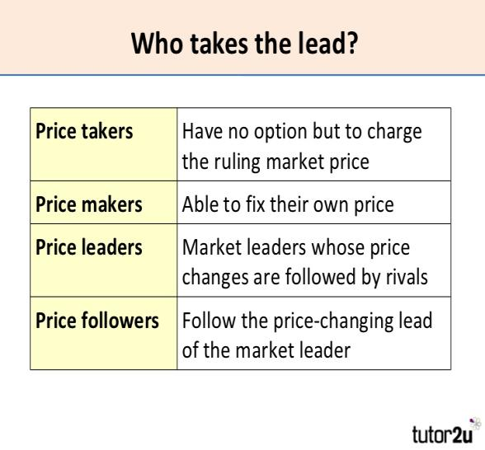

Price-Takers

Slide 15
Perfect Competition
(iv) Free entry and free exit : Any firm can enter or leave the industry whenever it wishes.
The condition of free entry and free exit ensures that all the firms under perfect competition will earn normal profits in the long run.
If the existing firms are earning supernormal profits, new firms would be attracted to enter the industry and increases the total supply. This will reduce the market price and the supernormal profit will not sustain. On the other hand if the existing firm incur supernormal loss then firms would leave the industry, thus reducing the supply. As a result, price will again rise and the loss will be wiped out.

Slide 16
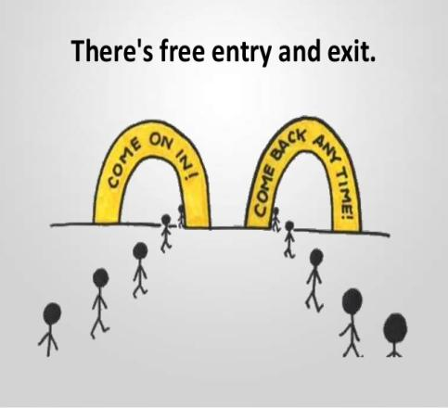
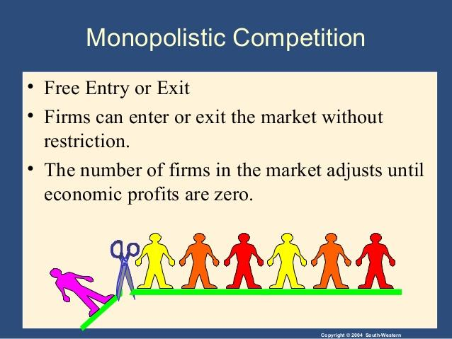
Perfect Competition

Slide 17
Perfect Competition
(v) Profit maximization :- The goal of all firms is maximization of profit.
(vi) No Government regulation :- There is no Government intervention in the market.
(vii) Perfect mobility of factors :- Resources can move freely from one firm to another without any restriction. The labours are not unionized and they can move between jobs and skills.
(viii) Perfect knowledge :- Individual buyer and seller have perfect knowledge about market and information is given free of cost. Each firm knows the price prevailing in the market and would not sell the commodity which is higher or lower than the market price.
Similarly, each buyer knows the prevailing market price and he is not allowed to pay a higher price than that. The firm also has a perfect knowledge about the techniques of productions. Each firm is able to make use of the best techniques of production.

Slide 18
Perfect Competition
(ix)Absence of transport cost
Transport cost is zero. price of the product is not affected by the cost of transportation.
(x) Perfectly elastic demand curve
Demand curve reflected by AR curve facing firm under perfect competition is perfectly elastic meaning that the firm can sell as much as it want at the ruling market price . Since price is uniform and given under perfect competition, both AR(price) and MR become equal. Thus, AR and MR curves coincide and become parallel to output axis.

Slide 19
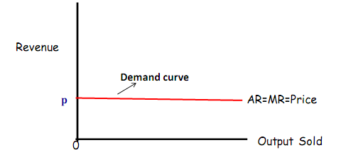
Perfectly elastic demand curve

Slide 20
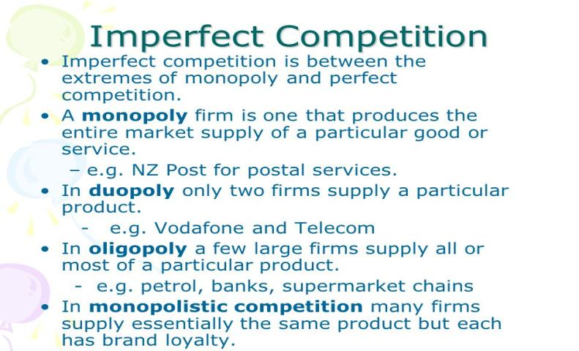
Imperfect Competition
Imperfectly competitive markets may be classified as : (i) Monopoly, (ii) Monopolistic Competition,
(iii) Oligopoly and (iv) Duopoly

Slide 21
Monopoly
(1) Monopoly
Monopoly refers to the market situation where there is one seller and there is no close substitute to the commodities sold by the seller. The seller has full control over the supply of that commodity.
Since there is only one seller, so a monopoly firm and an industry are the same.
Monopoly is a form of market structure where there is a single seller producing a commodity having no close substitute.
The word monopoly is derived from two Greek words-Mono and Poly. Mono means single and Poly means 'seller'. Thus monopoly means single seller.

Slide 22
Monopoly
Features :
(i) Single seller and large number of buyers : Under monopoly there is one seller and therefore a firm faces no competition from other firms. Though there are large numbers of buyers, no single buyer can influence the monopoly price by his action.
(ii) No close substitute : Under monopoly there is no close substitute for the product sold by the monopolist. According to Prof. Boulding, a pure monopolist is therefore a firm producing a product which has no substitute among the products of any other firms.
(iii) Restriction on the entry of new firms : Under monopoly new firms cannot enter the industry.

Slide 23
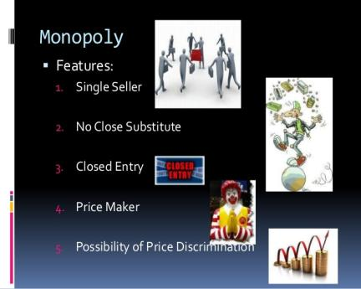
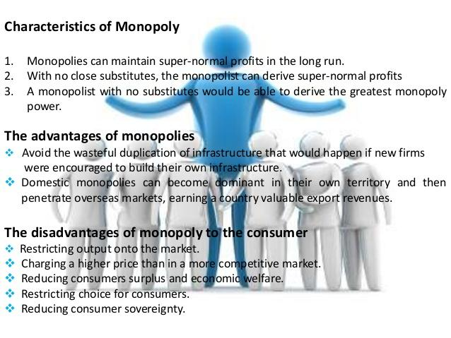
Monopoly

Slide 24
Monopoly
(iv) Price maker :- A monopoly firm has full control over the supply of its products and hence it has full control over its price also. A monopoly firm can influence the market price by varying it supply, for e.g., It can make the price of its product by supplying less of it.
(v) Possibility of Price Discrimination : Price discrimination is defined as that market situation where a single seller sell the same commodity at two different prices in two different markets at the same time, depending upon the elasticity of demand on the two goods in their respective market.
Under such circumstances a monopolist can incur supernormal loss then firms would leave the industry, thus reducing the supply. As a result, price will again rise and the loss will wiped out.

Slide 25
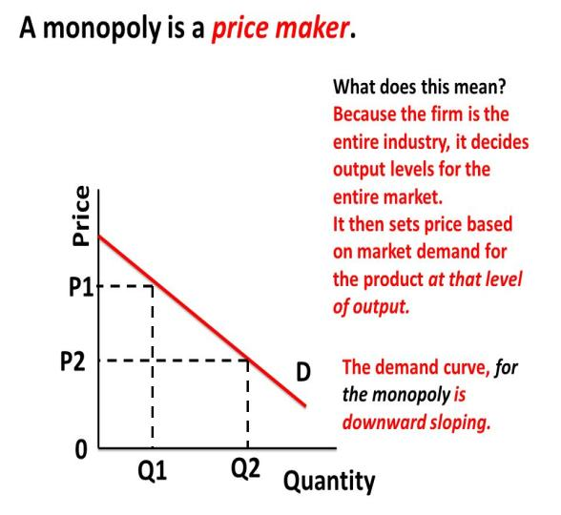
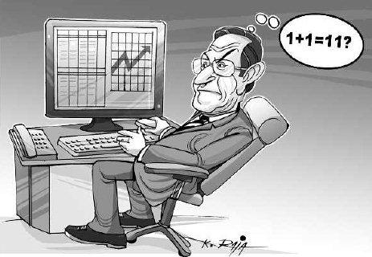
Monopoly

Slide 26
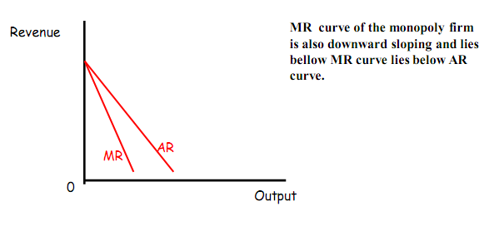
Monopoly
Downward sloping inelastic demand curve of a monopoly firm Demand curve of a firm reflected by its AR curve under monopoly is downward sloping meaning that the monopoly firm can sell more at a lower price and less at a higher price. The demand curve of the monopoly firm is highly inelastic. This is because the product does not have any close substitute.

Slide 27
Monopolistic Competition
(2) Monopolistic Competition
It is that form of market in which there are large numbers of sellers selling differentiated products which are similar in nature but not homogenous, for e.g.., the different brands of soap.
This are closely related goods with a little difference in odour, size and shape. We separate them from ach other.
The concept of monopolistic competition was developed by an American economist “Chamberline”. It is a combination of perfect competition and monopoly.

Slide 28
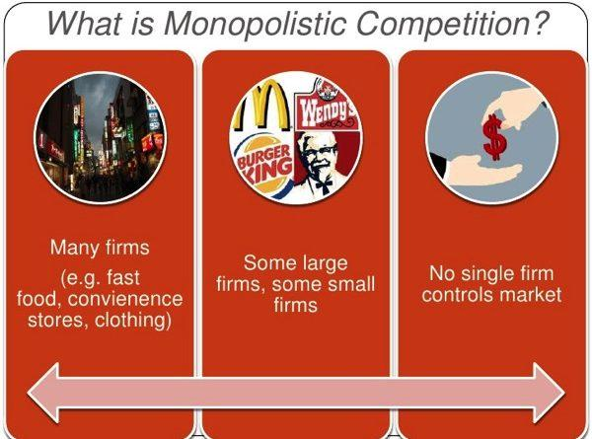
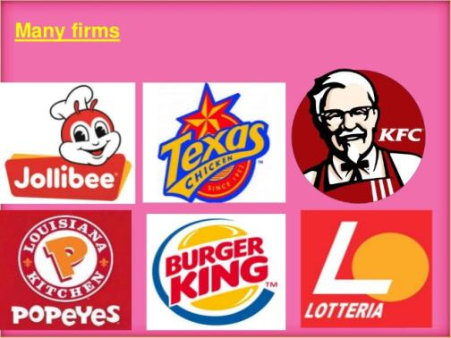
Monopolistic Competition

Slide 29
Monopolistic Competition
Monopolistic competition is a market situation in which both monopoly and competitive elements are present.
The most distinguished features of monopolistic competition which makes it a blending of competition and monopoly is product differentiation.
Product differentiation refers to the actively created differences in products with respect to brand, trademark, design, packing, colour, size, measurement, weight such that though the products are similar, they are not identical or in other words the products are different but closely related.

Slide 30
Monopolistic Competition
Features :
(i) Large number of sellers and buyers : In monopolistic competition the number of sellers is large and each other act independently without any mutual dependence. Here the action of an individual firm regarding change in price has no effect on the market price. The firms under monopolistic competition are not price takers.
(ii) Product Differentiation : Most of the firms under monopolistic sale products which are not homogenous in nature but are close substitutes. Products are differentiated from each other in the following ways:
(a) Real Differentiation : These types of product differentiation arises due to differences in the quality of inputs used in making these products, differences in location of firms and their sales service.
(b) Artificial Differentiation : It is made by the sellers in the minds of the buyers of those products through advertisements, attractive packing, etc.

Slide 31
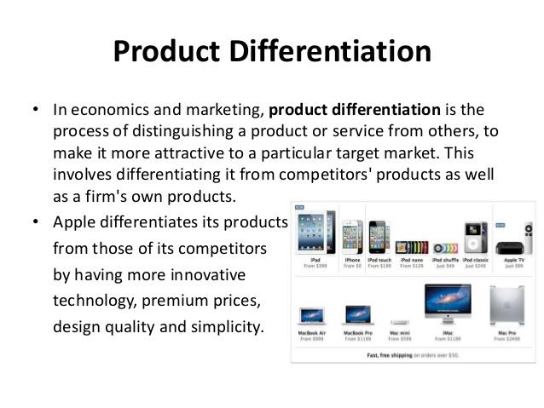

Monopolistic Competition

Slide 32
Monopolistic Competition
(iii) Non-price competition : In this case, different firms may compete with each other by spending a huge sum of money on advertisements keeping the product prices unchanged.
(iv) Selling Cost : Expenditure incurred on advertisements and sales promotion by a firm to promote the sale of its product is called selling cost. They are made to persuade a particular product in preference to other products. Some advertisements have become so popular that people use a brand name to describe the product, for e.g.., brand name is used to describe all types of washing powder.

Slide 33
Monopolistic Competition
(Selling costs are the expenses incurred on advertisement, publicity, salesmanship etc. Selling costs are incurred by the firms to make aware of the product, to attract new customers, to create customer base and loyalty).

Slide 34
Monopolistic Competition
(v) Free Entry And Free Exit : There are no restrictions on the entry of new firms and the firms decide to leave the industry.
Every firm under monopolistic competition earns only normal profits in the long run and there arises no supernormal profit nor loss.
(vi) Independent price policy : A firm under monopolistic competition can influence the price of the commodity to some extent and hence they face an inverse relationship between price and quantity. In this case the price elasticity of demand would be relatively elastic because of the existence of many substitutes.

Slide 35
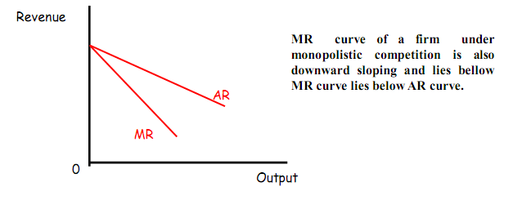
Monopolistic Competition
Downward sloping highly elastic demand curve of a firm under monopolistic competition
Demand curve of a firm reflected by its AR curve under monopolistic competition is downward sloping. The demand curve is highly elastic. This is because differentiated products under monopolistic competition has more close substitutes.

Slide 36
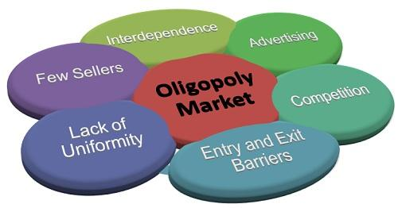
Oligopoly
(3) Oligopoly
Oligopoly is a market situation in which there are few firms producing either differential goods or closely differential goods. The number of firms is so small that every seller is affected by the activities of the others.

Slide 37
Oligopoly
Oligopoly is a market situations in which there are few (more than two) sellers of a commodity such that actions of every seller has predictable effect on the other sellers/rivals.
Hence, oligopoly is also called competition amongst the few.
Oligopoly may be of two types can two forms:
pure oligopoly or oligopoly without product differentiation.
differentiated oligopoly or oligopoly with product differentiation.

Slide 38
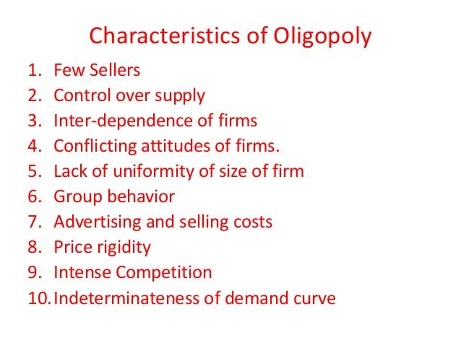
Oligopoly

Slide 39
Oligopoly
Features :
(i) Few Sellers : There are few sellers in oligopoly market, such that number of sellers is small that each and every seller is affected by the activities of the others.
(ii) Interdependence : Interdependence among firms is the most important characteristic under Oligopoly. The number of sellers is so less in the market that each of these firms contribute a significant portion of the total output. As a result, when any one of them undertakes any measure to promote sales, it directly affect other firms and they also immediately react.
Hence every firm decides its policy after taking into consideration the possible reaction of the rival firm. Thus every firm is affected by the activities of the other firms and this is called interdependence of firm.
(iii) Nature of Product : A firm under oligopoly may produce homogenous goods which is called oligopoly without product differentiation for e.g.. Cooking gas supplied by Indian Oil & HP.

Slide 40
Oligopoly
Oligopoly may also produce differential products which is called oligopoly with product differentiation for e.g.. Automobile Industry.
(iv) Barrier to Entry : The existence of oligopoly in the long run requires the existence of barrier to the entry of the new firms. Several factors such as unlimited size of the market, requirement of huge initial investment etc. creates such barrier upon the entry of new firms.

Slide 41
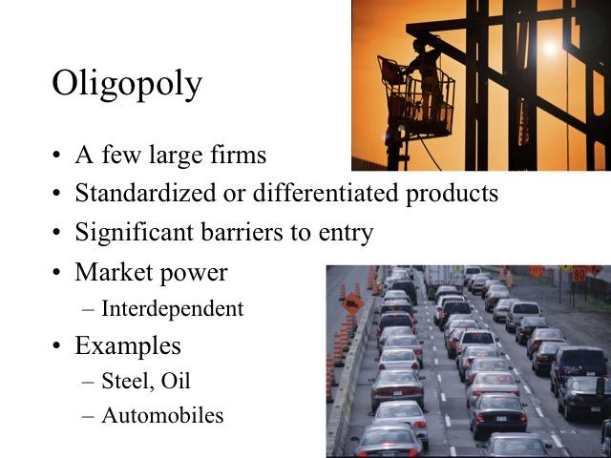
Oligopoly

Slide 42
Duopoly
Duopoly
It is a specific type of oligopoly where only two producers exist in one market. In reality, this definition is generally used where only two firms have dominant control over a market.
Duopoly provides a simplified model for showing the main principles of the theory of oligopoly: the conclusions drawn from analysing the problem of two sellers can be extended to cover situations in which there are three or more sellers. If there are only two sellers producing a commodity a change in the price or output of one will affect the other; and his reactions in turn will affect the first. In other words, in duopolies there are two variables of interest: the prices set by each firm and the quantity produced by each firm.

Slide 43
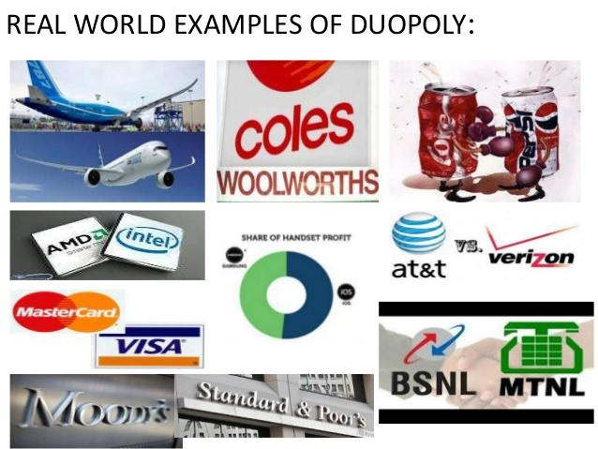
Duopoly

Slide 44
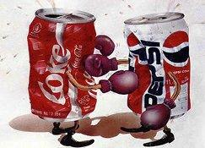
Duopoly
Duopoly is a market situation in which there are two sellers of a commodity such that actions of each seller has predictable effect on the other seller/rival.

Slide 45
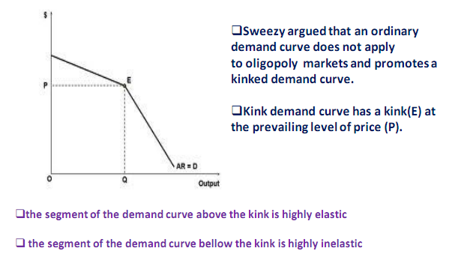
Price-Rigidity And Paul Sweezy’s Kinked Demand Curve

Slide 46
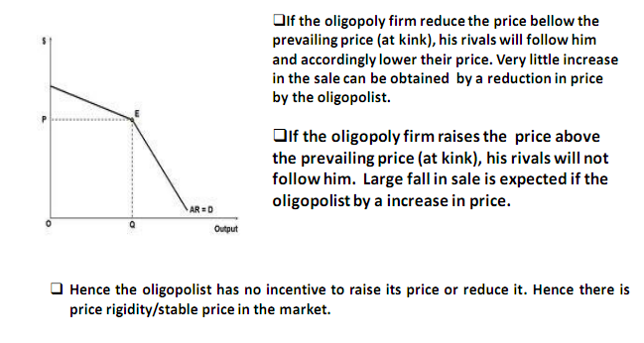
Price-rigidity And Paul Sweezy’s Kinked Demand Curve

Slide 47

Revenue
The term revenue refers to the receipts obtained by a firm from the sale of certain quantities of a commodity at various prices. The revenue concept relates to total revenue, average revenue and marginal revenue.

Slide 48
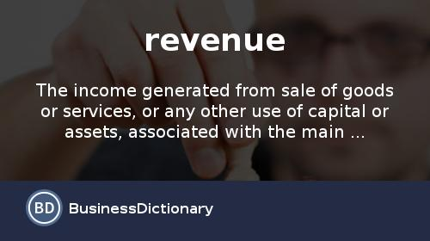
Revenue
Revenue is the receipt of money from the sale of output by a firm in a given time period.
Concepts of Revenue
Total Revenue
Average revenue
Marginal Revenue

Slide 49
Concepts Of Total Revenue, Average Revenue And Marginal Revenue
Total Revenue (TR)- Total revenue is the total sale proceeds of a firm by selling certain units of a commodity at a given price.
If a firm sell 10 units of a commodity at ` 20 each, Them TR = 20 x 10 = ` 200.00
Thus total revenue its price per unit multiplied by the number of units sold.
TR = P x Q where P - Price per unit Q - Quantity sold.
TR = AR X Q = 𝑴𝑹

Slide 50
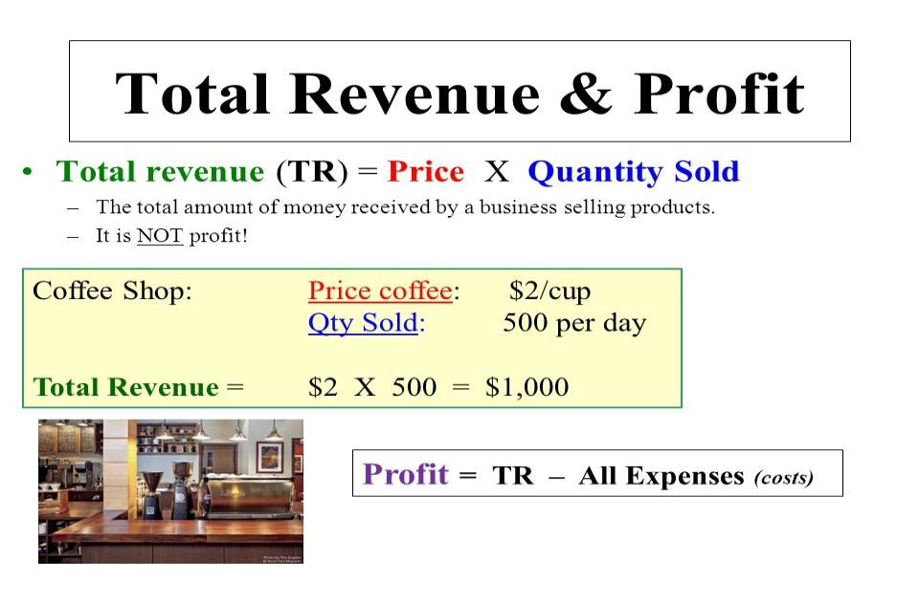
Total Revenue (TR)

Slide 51
Concepts Of Total Revenue, Average Revenue And Marginal Revenue
Average Revenue (AR) - Average Revenue is the revenue earned per unit of output. Average Revenue is found out by dividing the total revenue by the number of units sold.
AR = TR/Q
TR = P.Q
Thus AR = P.Q/Q = P

Slide 52
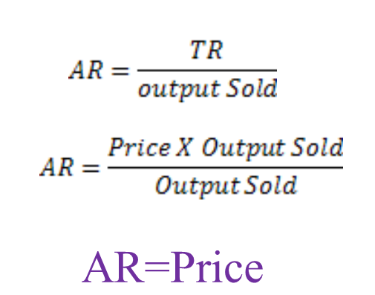
Concepts Of Total Revenue, Average Revenue And Marginal Revenue
Average Revenue

Slide 53
Concepts Of Total Revenue, Average Revenue And Marginal Revenue
Marginal Revenue - Marginal Revenue is the change in total revenue resulting from sale of an additional unit of the commodity.
e.g. If a seller realises ` 200.00 after selling 10 units and `225 by selling 11 units, we say MR = (225.00 - 200.00) = ` 25.00
Mathematically it can be expressed as
MR = dTR/ dQ
Where d is the rate of change.

Slide 54
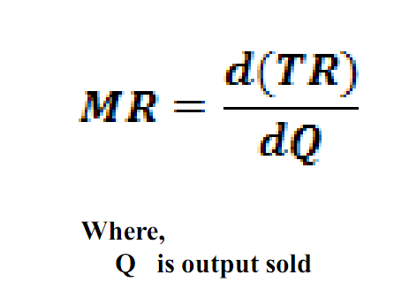
Concepts Of Total Revenue, Average Revenue And Marginal Revenue
Marginal Revenue (MR) is the rate of change in total revenue with respect to change in output.

Slide 55
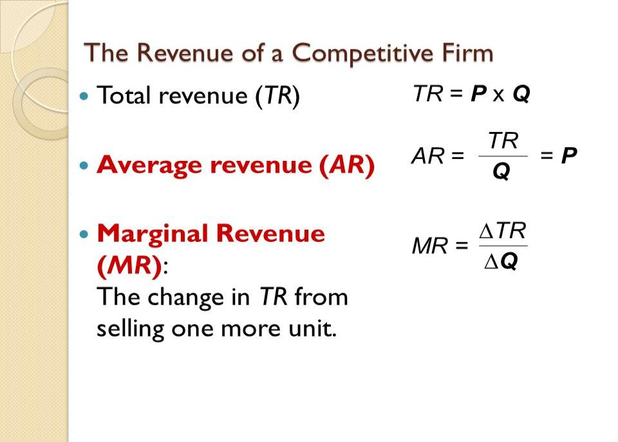
Concepts Of Total Revenue, Average Revenue And Marginal Revenue

Slide 56
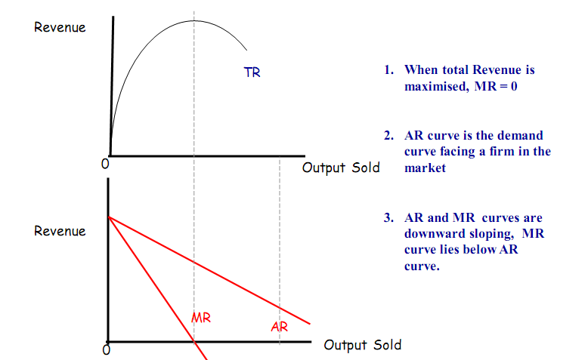
TR, AR And MR Under Im-perfect Competition

Slide 57
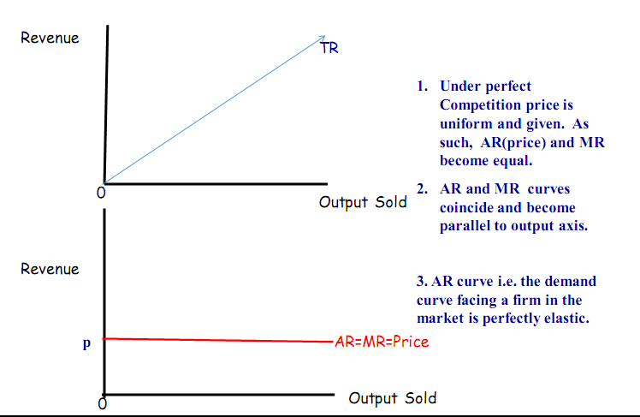
TR, AR and MR under Perfect Competition

Slide 58

Profit
Profit is defined as the gap between total revenue and total cost.
Profit(∏ ) =Total Revenue – Total Cost
When profit is negative, a firm is said to be suffering from loss.

Slide 59
Profit
BREAK -EVEN POINT
Break-even point indicates the level of output at which Total Revenue just equals Total Cost .
EQUILIBRIUM OFA FIRM
A firm is said to in equilibrium when it maximises its profit at given level of output.
Thus, at firm’s equilibrium, profit(TR-TC) is maximum.

Slide 60
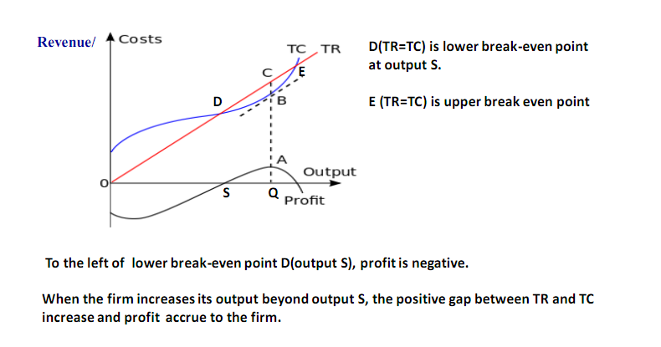
Break-Even Point and Firm’s Equilibrium(Maximum Profit)

Slide 61
Break-Even Point and Firm’s Equilibrium(Maximum Profit)
The firm is in equilibrium (maximum profit =CB=AQ) at Q level of output after which the gap between TR and TC goes on narrowing. TR again becomes equal to TC at upper break even point E.
Upper break-even E point is not of much relevance as it lies beyond firm's profit maximizing level.
Further, it lies beyond the firm’s capacity.
The lower break even point D at output S is much significance as the firm would not plan to expand if it can not sell its output equal to at least S.

Slide 62
Equilibrium Of A Firm
A firm is said to in equilibrium when it maximises its profit at given level of output. Thus, at firm’s equilibrium, profit(TR-TC) is maximum.
Conditions For Profit Maximisation/Firm’s Equilibrium:
MR=MC (Necessary Condition)
MC must be rising at the profit maximising/equilibrium point i.e. MC curve must cut MR curve from bellow(Sufficient Condition)

Slide 63
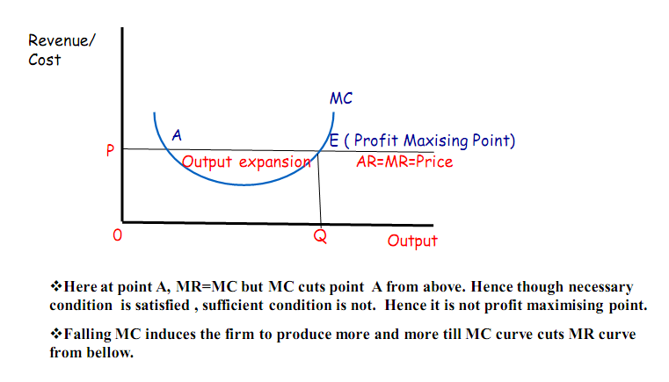
Equilibrium of a firm /Profit Maximisation by a firm

Slide 64
Equilibrium of a firm /Profit Maximisation
At point E , MR=MC and MC curve cuts MR curve from bellow. At E, both necessary and sufficient conditions are satisfied. Hence E is the point of equilibrium at which the firm maximises its profit.
Q is the equilibrium or profit maximising output. The firm will not produce beyond point E or output Q . Because after point E, MR < MC. As a result of which the firm will suffer loss.

Slide 65


Thanks…

